Slide 1

Customer Retention & Churn Analysis
By Gomolemo Moabalobelo

Slide 2

TABLE OF Content
Introduction 4-5 1.1 Project Overview 1.2 Objectives of the Analysis
Customer Churn Analysis 6-7 2.1 Churn Rate by Subscription Plan 2.2 Churn Rate by Average Weekly Usage 2.3 Churn Rate by Support Requests 2.4 Churn Rate by Payment Failures 2.5 Monthly Churn Rate Trends
Customer Retention Analysis 8-9 3.1 Retention Rate by Subscription Plan 3.2 Retention Rate by Usage Levels 3.3 Monthly Retention Trends

Slide 3
TABLE OF Content
Customer Cohort Analysis 9-11 5.1 Total Customers by Subscription Duration 5.2 Customer churn rates 5.3 Customer usage
5.4 customer Plan type
Customer lifetime Patterns 11
Recommendations 12
Conclusion 13

Slide 4

Introduction
Project Overview
This project focused on analyzing customer subscription behaviour to understand patterns related to churn, retention, customer engagement, and subscription performance. The analysis examined customer activity across different subscription plans, usage levels, payment behaviours, support requests, and customer lifecycle stages to identify factors influencing customer retention and cancellations.
Analysis Performed
Churn rate analysis by plan, monthly trends, average weekly usage, support requests, and payment failures.
Retention rate analysis by plan, customer usage levels, and monthly performance.

Slide 5
Introduction
Analysis Performed
Customer cohort analysis based on subscription duration and customer lifecycle stages such as new, early-stage, established, and loyal users.
Customer growth analysis by subscription plans and average weekly usage.
Comparative analysis of customer behaviour across different customer segments and time periods.
Key Focus of the Analysis
Identifying churn rates and retention trends across customer segments and subscription plans.
Analyzing customer cohorts to understand customer behaviour over time.
Evaluating customer lifetime patterns based on loyalty, engagement, and subscription duration.
Identifying key drivers of customer retention and major reasons contributing to customer churn.

Slide 6
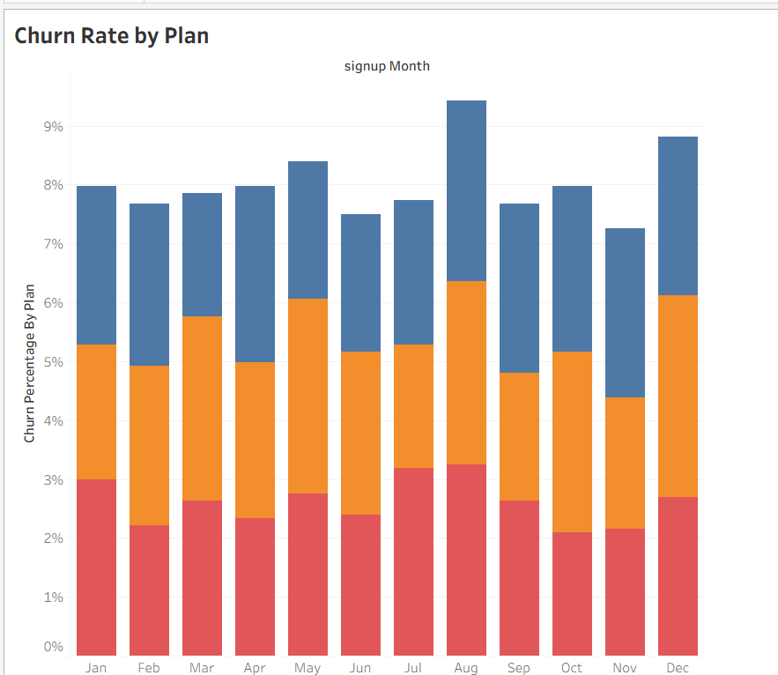
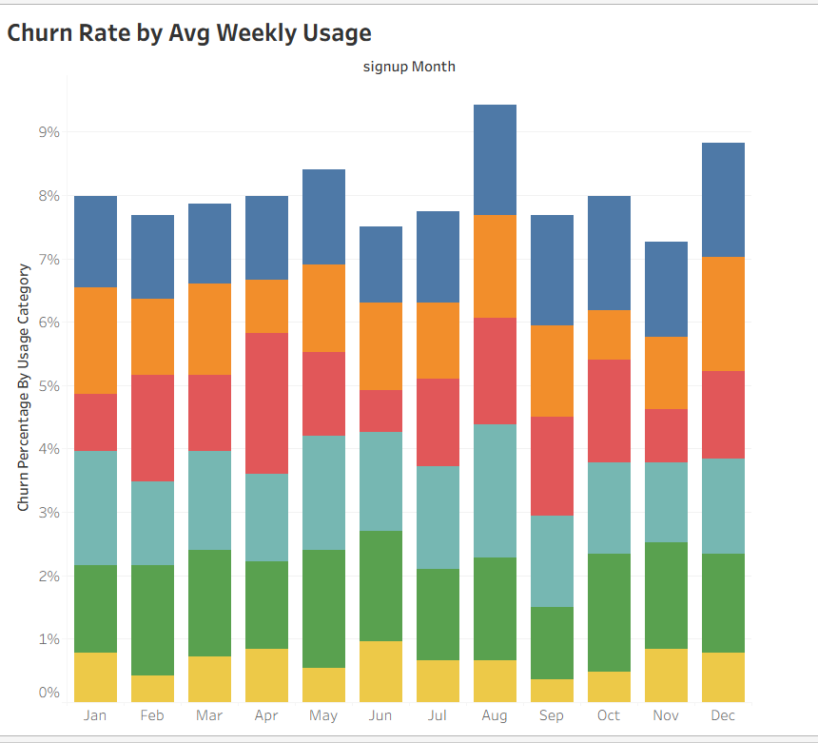
Churn Rate by Plan & Usage
Key Insights
Churn rates across subscription plans remain relatively close each month, indicating that customer cancellations are evenly distributed across the different plans.
August recorded the highest churn rate at 9.42%, followed by December at 8.82%, while November had the lowest churn rate at 7.26%.
In November, the Basic and Standard plans had the same churn rate of 2.70%, whereas the Premium plan recorded the highest churn rate at 3.43%.
Business Insights
The evenly distributed churn rates suggest that customer churn is influenced more by overall customer experience than by a specific subscription plan.
Higher churn during August and December may indicate seasonal cancellation behaviour, creating an opportunity for targeted retention campaigns during these periods.
The higher churn rate in the Premium plan suggests the business should evaluate whether premium subscribers are receiving sufficient value for the price they pay.
Key Insights
Customers with Very High Usage recorded the highest churn rate at 19.08%, while Very Low Usage customers had the lowest churn rate at 8.04%.
August recorded the highest overall churn rate at 9.42%, whereas November had the lowest churn rate at 7.26%.
In August, Power Users contributed the highest churn at 2.10%, while Very Low Usage customers recorded the lowest at 0.66%. In November, Moderate Usage had the lowest churn at 0.84%, while Very High Usage recorded 1.68%.
Business Insights
Higher churn among heavy users suggests possible dissatisfaction with service value, pricing, or performance.
Lower churn among low-usage customers indicates casual users are more likely to remain subscribed.
The business should focus retention efforts on high-usage customers through improved customer experience, loyalty incentives, and targeted engagement strategies.

Slide 7
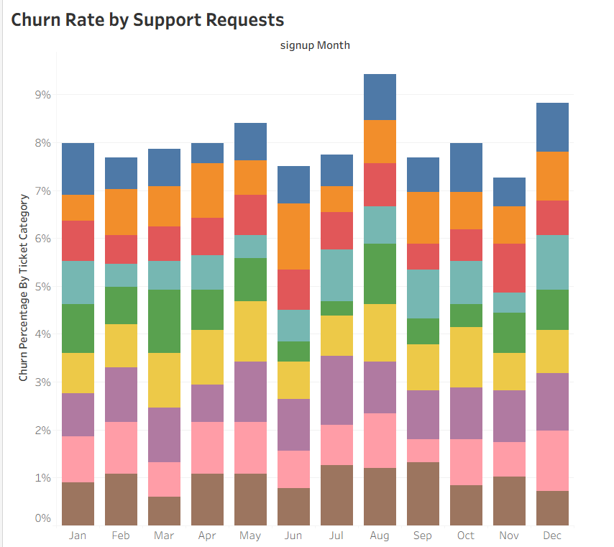
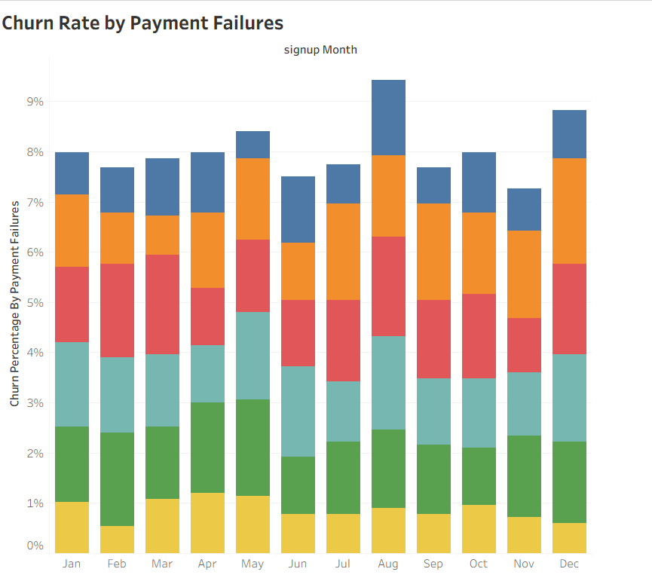
Churn Rate by Support Requests & Payment Failures
Key Insights
Customers with six support requests had the highest churn rate at 13.20%, while those with three requests had the lowest at 9.18%. August recorded the highest overall churn at 9.42%, whereas November had the lowest at 7.26%.
In August, four support requests had the highest churn contribution (1.26%), while three requests were lowest (0.78%). In November, six support requests had the highest churn (1.08%), while three requests were lowest (0.42%).
Business Insights
High support requests are linked to higher churn, suggesting unresolved issues or poor service experience drive cancellations. Customers with fewer support requests show lower churn, indicating smoother experiences improve retention.
The business should improve support quality, response time, and issue resolution to reduce churn among high-need customers.
Key Insights
Customers with three payment failures recorded the highest churn rate at 18.96%, while those with no payment failures had the lowest churn at 10.50%. August recorded the highest churn rate at 9.42%, while November had the lowest at 7.26%.
In August, customers with three payment failures had the highest churn contribution at 1.98%, while those with no failures were lowest at 0.90%. In November, customers with two payment failures had the highest churn at 1.72%, while those with no failures were lowest at 0.72%.
Business Insights
Higher payment failures are strongly linked to higher churn, showing that failed transactions directly impact customer retention. Customers with no payment failures have significantly lower churn, highlighting the importance of smooth payment processes. The business should improve payment reliability, reduce transaction errors, and implement better payment recovery systems to minimize churn.

Slide 8
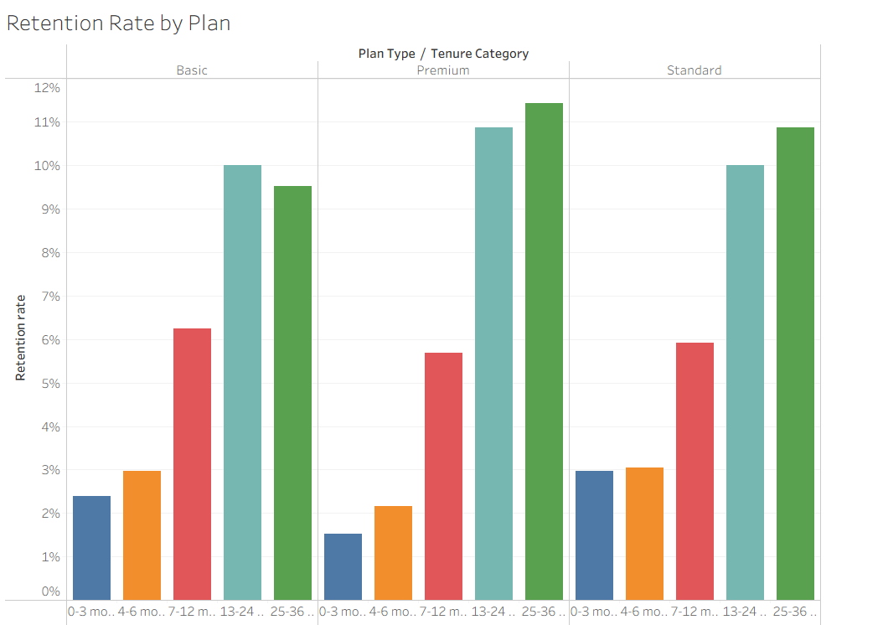
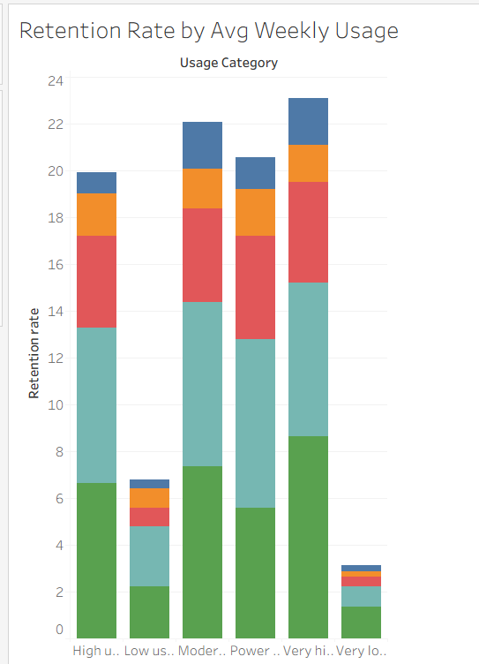
Retention Rate by Plan & Usage
Key Insights
The retention rate across all plans is relatively similar at approximately 33%.
In the Basic plan, established users have the highest retention rate at 10%, while new users are lowest at 2.40%. In the Premium plan, loyal users lead with 11.44%, while new users are lowest at 1.52%. In the Standard plan, loyal users again record the highest retention at 10.88%, while new users are lowest at 2.96%.
Business Insights
Retention is strongest among loyal and established users across all plans, showing that long-term customers are more stable. New users consistently show the lowest retention, indicating onboarding or early engagement issues. The business should improve onboarding experiences, strengthen early-stage engagement, and build loyalty programs to increase retention among new customers.
Key Insights
Very high usage customers record the highest retention rate at 23.12%, while very low usage customers have the lowest at 3.12%. Overall, loyal users show the strongest retention at 31.84%, while new users have the lowest at 6.88%.
Within very high usage, loyal users lead at 8.64%, while early-stage users are lowest at 1.60%. In very low usage, loyal users are highest at 1.36%, while new and early-stage users are lowest at 0.24%.
Business Insights
Retention is strongly driven by usage level and customer maturity, with loyal and high-usage customers being the most stable segments. Low-usage and new users show weak retention, indicating early disengagement.
The business should focus on increasing engagement in the early stages and converting new users into active and loyal customers through onboarding and value-driven features.

Slide 9
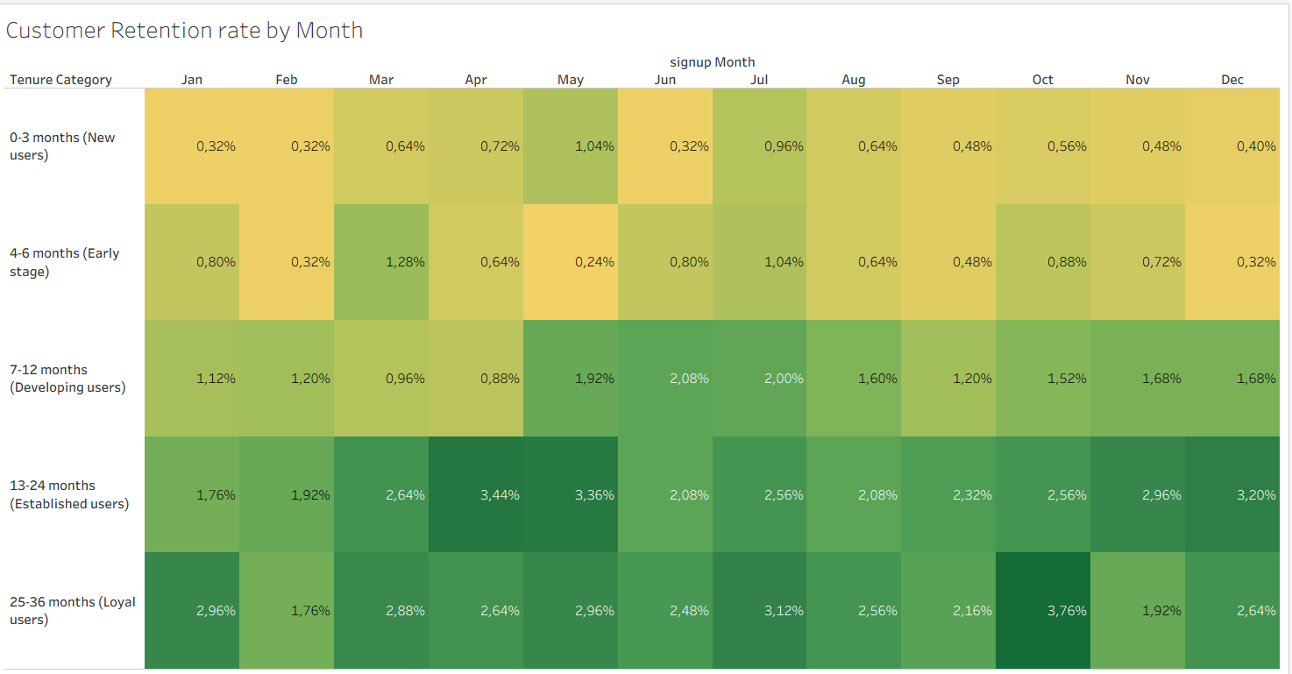
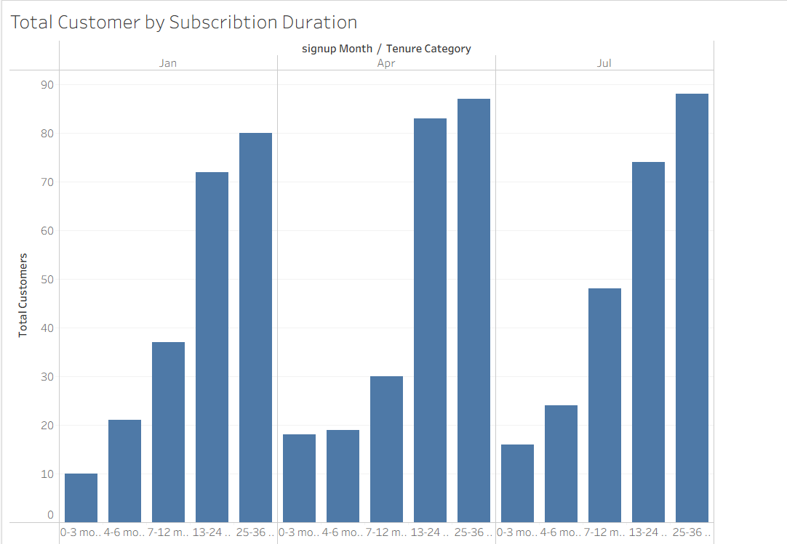
Retention Rate & Customer by Subscription Duration
Key Insights
July recorded the highest retention rate at 9.68%, while February had the lowest at 5.52%. Overall, loyal users show the highest retention at 31.84%, while new users have the lowest at 6.88%.
In July, loyal users had the highest retention at 3.12%, while new users were lowest at 0.96%. In February, established users led with 1.92%, while both new and early-stage users recorded the lowest retention at 0.32%.
Business Insights
Retention is strongest among loyal and established users, showing that long-term customers are more stable and valuable. New and early-stage users consistently show low retention, indicating weak early engagement. The business should focus on improving onboarding, early user experience, and engagement strategies to improve retention in the first stages of the customer journey.
Key Insights
Total customers increased over time, with 220 in January, 237 in April, and 250 in July, showing steady growth in sign-ups.
Loyal users consistently made up the majority of customers across all months, with 80 (Jan), 87 (Apr), and 88 (Jul), while new users remained much lower at 10 (Jan), 18 (Apr), and 16 (Jul).
Business Insights
Customer growth is stable and gradually increasing, indicating positive acquisition trends. However, new users remain significantly lower than loyal users, suggesting a strong reliance on returning customers rather than fresh acquisition. The business should strengthen marketing and onboarding strategies to attract more new users while maintaining loyalty among existing customers.

Slide 10
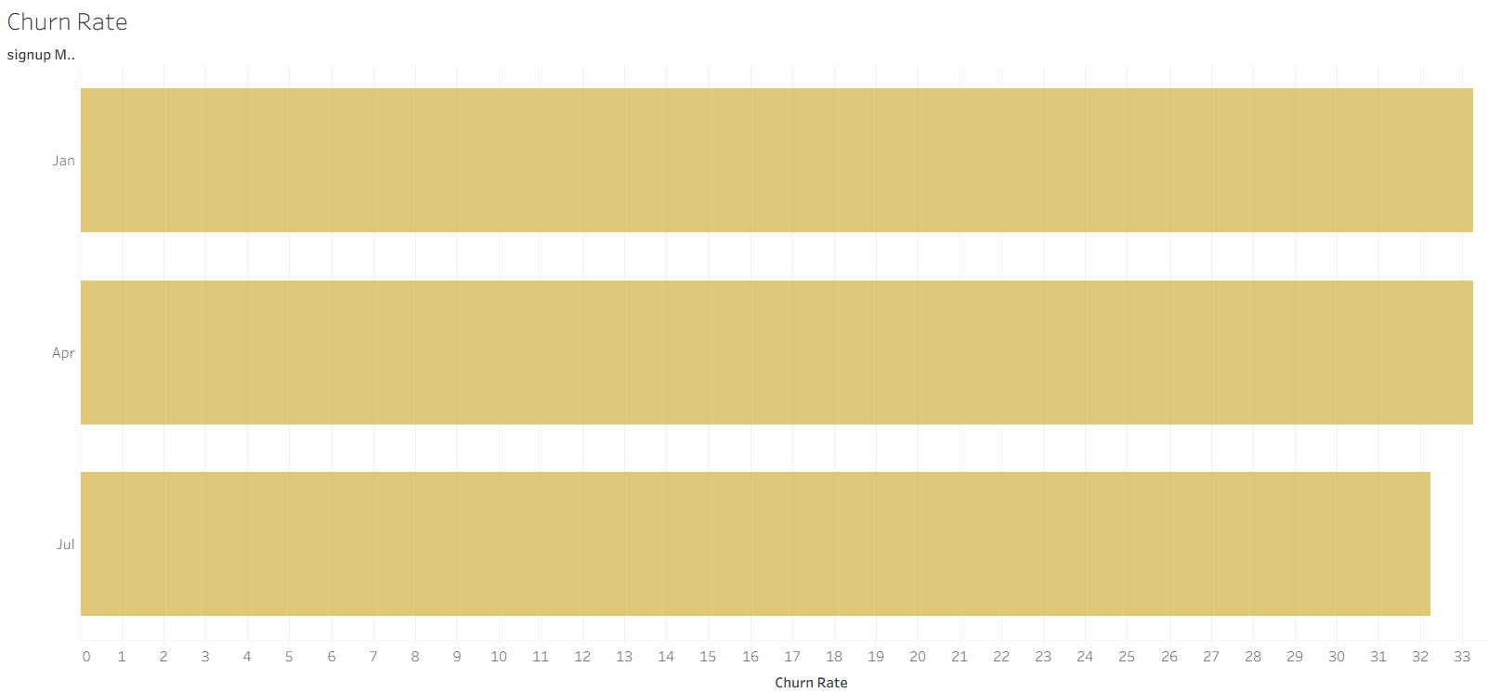
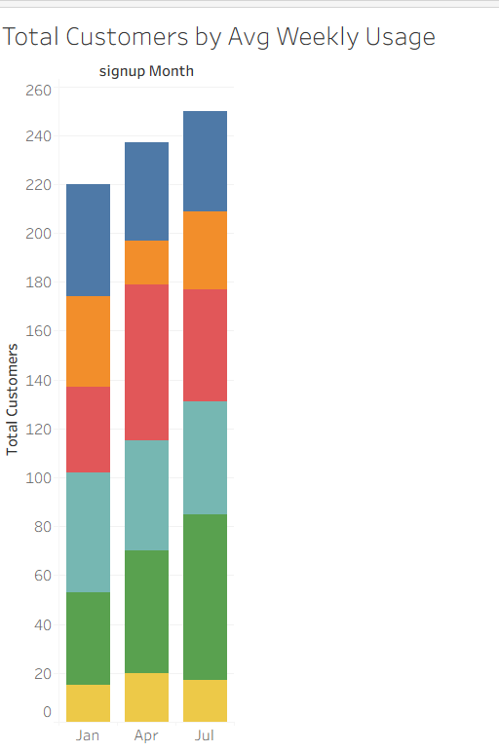
Customer Cohorts Analysis
Key Insights
Churn rates remained almost stable across the period, with January and April both at 33.26%, and a slight decrease in July at 32.25%.
Business Insights
The minimal change in churn rate suggests that customer
retention challenges are consistent over time rather than seasonal. The slight improvement in July indicates early signs of better retention, but overall churn remains high.
The business should focus on strengthening retention strategies to drive a more significant reduction in churn.
Key Insights
Total customers increased steadily from 220 in January, to 237 in April, and 250 in July, showing consistent growth.
In January, there were 49 power users and 15 very low usage customers. In April, 64 customers were moderate users and 18 were low usage. In July, 68 customers were very high usage and 17 were very low usage, indicating a shift toward higher engagement levels over time.
Business Insights
Customer growth is accompanied by increasing usage intensity, suggesting improving engagement quality over time. The rise in high and moderate usage users indicates stronger product adoption. However, the presence of low and very low usage customers across all months highlights an ongoing need to improve onboarding and activation strategies to boost engagement among new users.

Slide 11
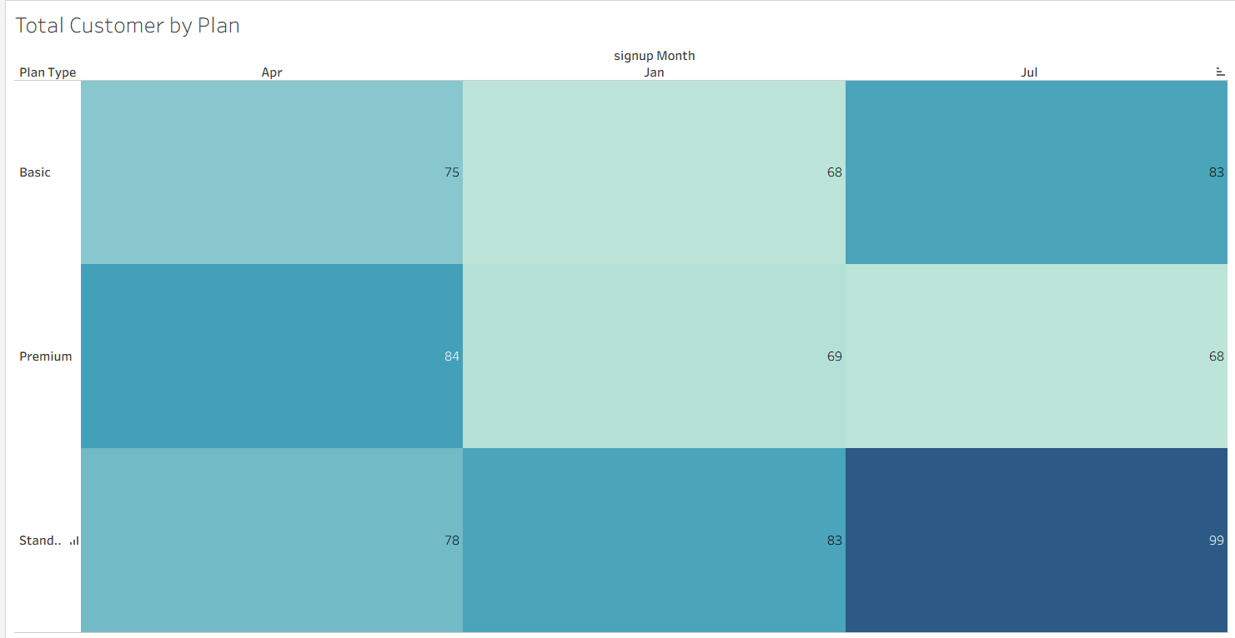
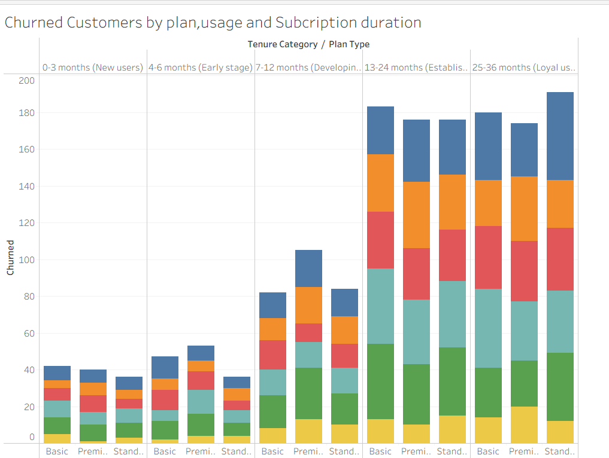
Customer Cohorts and lifetime Patterns
Key Insights
The Standard plan has the highest total users at 260, followed by Basic (226) and Premium (221). Monthly sign-ups increased from 220 (Jan) to 237 (Apr) and 250 (Jul).
In January, most users chose the Standard (83) and Basic (68) plans. In April, the Premium plan (84) led, followed by Basic (75). In July, the Standard plan (99) had the highest uptake, followed by Premium (68).
Business Insights
User preference shifts across months suggest that plan popularity is influenced by changing customer needs or promotions. The Standard plan shows the strongest overall demand, making it a key revenue driver.
The business should focus on strengthening the value proposition of the Premium and Basic plans while maintaining the strong performance of the Standard plan.
Key Insights
Loyal users recorded the highest number of churned customers, with the Standard plan contributing the most churn at 191 customers, while the Premium plan had the lowest churn among loyal users at 174 customers. Across both loyal and new users, high-usage and power users contributed the largest share of churn, whereas very low-usage users consistently recorded the lowest churn counts. Among new users, the Basic plan had the highest churn at 42 customers, while the Standard plan had the lowest at 36 customers.
Business Insights
The high churn among loyal and highly engaged users suggests that long-term and active customers may still experience dissatisfaction related to service quality, value, or customer experience. The consistent churn among high-usage customers indicates that heavily engaged users may require more personalized support and retention efforts. The business should strengthen loyalty programs, improve customer engagement strategies, and enhance service quality to retain valuable long-term and high-usage customers.

Slide 12
Recommendations
Strengthen customer retention strategies by focusing on high-risk groups such as heavy users, customers with multiple support requests, and users experiencing payment failures. Personalized engagement, loyalty rewards, and proactive customer support can help reduce churn.
Improve onboarding and early-stage customer engagement, as new and early-stage users consistently show lower retention rates. Guided onboarding, tutorials, and targeted communication can increase customer activation and long-term loyalty.
Enhance customer support quality and issue resolution processes to reduce dissatisfaction among customers with frequent support requests. Faster response times and proactive follow-ups may improve customer experience and retention.
Optimize payment systems by reducing transaction failures and introducing automated payment reminders, retry mechanisms, and flexible payment options to minimize churn caused by payment issues.
Leverage the strong performance of the Standard and loyal-user segments by maintaining competitive value offerings while also improving the attractiveness of Basic and Premium plans through tailored features and pricing strategies.
Increase marketing and acquisition efforts to attract more new customers, as growth is currently driven more by loyal and returning users than by new-user acquisition.
Focus on increasing customer engagement among low-usage users through personalized recommendations, feature education, and targeted campaigns to encourage higher product adoption and retention.

Slide 13
Conclusions
The analysis indicates that the business is experiencing steady growth in customer numbers over time, with increases recorded from January to July. The Standard plan consistently attracted the highest number of users, while loyal customers formed the largest and most stable customer segment across the business. This demonstrates that the company has a strong base of returning customers who contribute significantly to retention and long-term business performance.
Despite this growth, churn rates remain relatively high and stable across the analyzed months, indicating ongoing customer retention challenges. The findings show that churn is not heavily concentrated within a single subscription plan, suggesting that broader factors such as customer experience, service quality, and engagement are influencing customer cancellations across all plans.
The analysis also revealed that customers with very high usage levels, multiple support requests, and repeated payment failures are more likely to churn. This suggests that highly engaged customers may experience unmet expectations, service frustrations, or dissatisfaction that increases the likelihood of cancellation. Similarly, customers with frequent support requests may not be receiving effective issue resolution, while payment failures appear to negatively affect customer retention and subscription continuity.
Retention analysis showed that loyal and established users consistently have the highest retention rates, while new and early-stage users have the lowest retention across plans, usage levels, and months. This indicates that the business is successful at maintaining long-term customers but faces challenges in retaining customers during the early stages of their journey. Additionally, low-usage customers showed weaker retention levels, highlighting the importance of improving customer engagement and product adoption.
Overall, the findings suggest that the business has a strong loyal customer base and positive customer growth trends, but improving retention should remain a key priority. Strengthening onboarding processes, improving customer support quality, reducing payment-related issues, and increasing customer engagement will be essential for reducing churn, improving customer satisfaction, and supporting sustainable long-term business growth.

Slide 14

THANK YOU!

